Slide 1
Fintech Project 2
Seasonal Flu Vaccination
By Kit N., Lucas F. and Navpreet N.

Slide 2
Project Proposal
Our project aims to predict whether individuals will receive their seasonal flu vaccine.
We explore the US National 2009 H1N1 flu survey data to study the vaccination pattern.
We fit a machine learning model with random forest classifier to the vaccination data.
We explore various tuning technique include:
Feature selection to reduce the number of input features
Hyperparameter tuning with RandomizedSearchCV,
Hyperparameter tuning with GridSearchCV.
A second machine learning with deep learning is considered.
We compare the performance of each model.
Notes:
Accuracy score is the focused performance metrics. This metrics measures the number of correct predictions made by a model in relation to the total number of predictions made.

Slide 3
The Dataset
We use the U.S National 2009 H1N1 flu survey (NFHS) data. This dataset is a copy shared by the U.S National Centre for Health Statistics for a data science competition hosted by DrivenData.
The NFHS data contains 26,707 survey respondents. Each survey respondents were asked whether they have received the H1N1 and seasonal flu vaccines and additional questions about themselves such as social, economic and demographic background, opinion and risks of illness and vaccine effectiveness, and behaviour towards mitigating transmission.

Slide 4
Data checking and cleaning
Class balance – Our target variable has balanced classes.
Missing values (Recall that our data has c.30 features)
Observation:
- 3 feature columns have more than 40% missing value. These features are excluded from our modelling.
- The proportion of missing values observed in other features ranges between 0% - 17%.
Strategy for replacing missing values:
We replace missing value with the most_frequent value observed using sklearn.impute.SimpleImputer module. This works well for both numerical and categorical variables.
Data types - Dataset has both numerical and categorical variables. Categorical variables are encoded into numerical values using sklearn.preprocessing.OneHotEncoder.

Slide 5
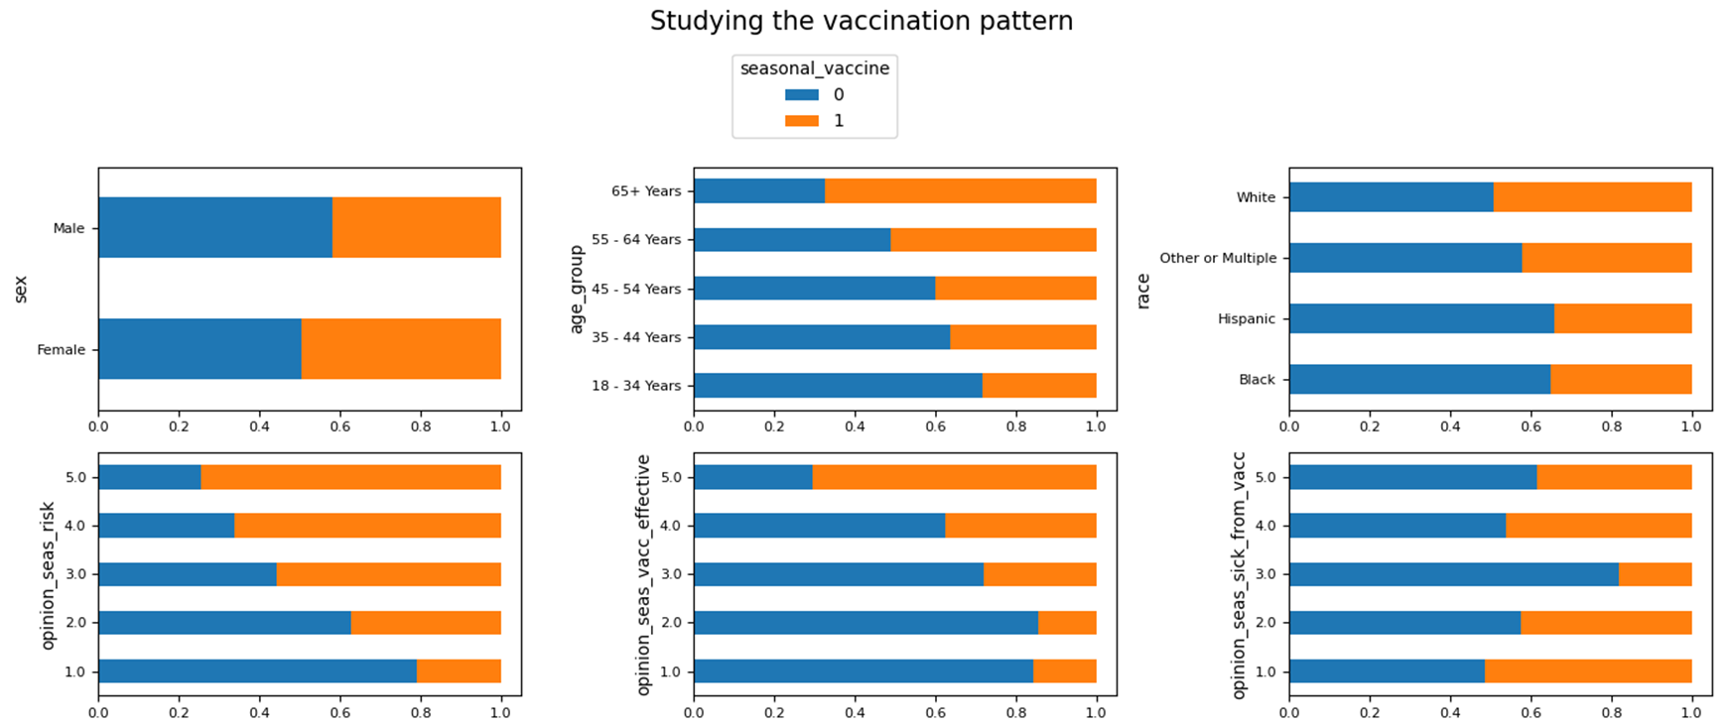
Exploring the data
Explore how the features are correlated with the target variable. If a feature is correlated with target, we expect to see different vaccination pattern as the values of the feature vary.
Notes:
Plot each feature against the target variable. From the sample plots, opinion questions are pretty strong signal to the target but much less for gender.

Slide 6
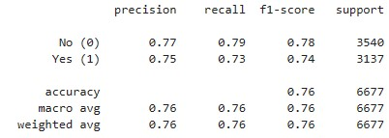
Establish Baseline Model
Random forest model chosen as baseline due to high accuracy and ability to handle large, complex datasets.
Robust to overfitting, ensuring good generalization performance on new data.
Simple to implement and requires minimal fine-tuning.

Slide 7
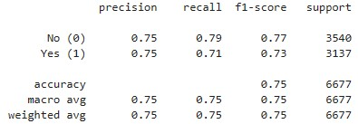
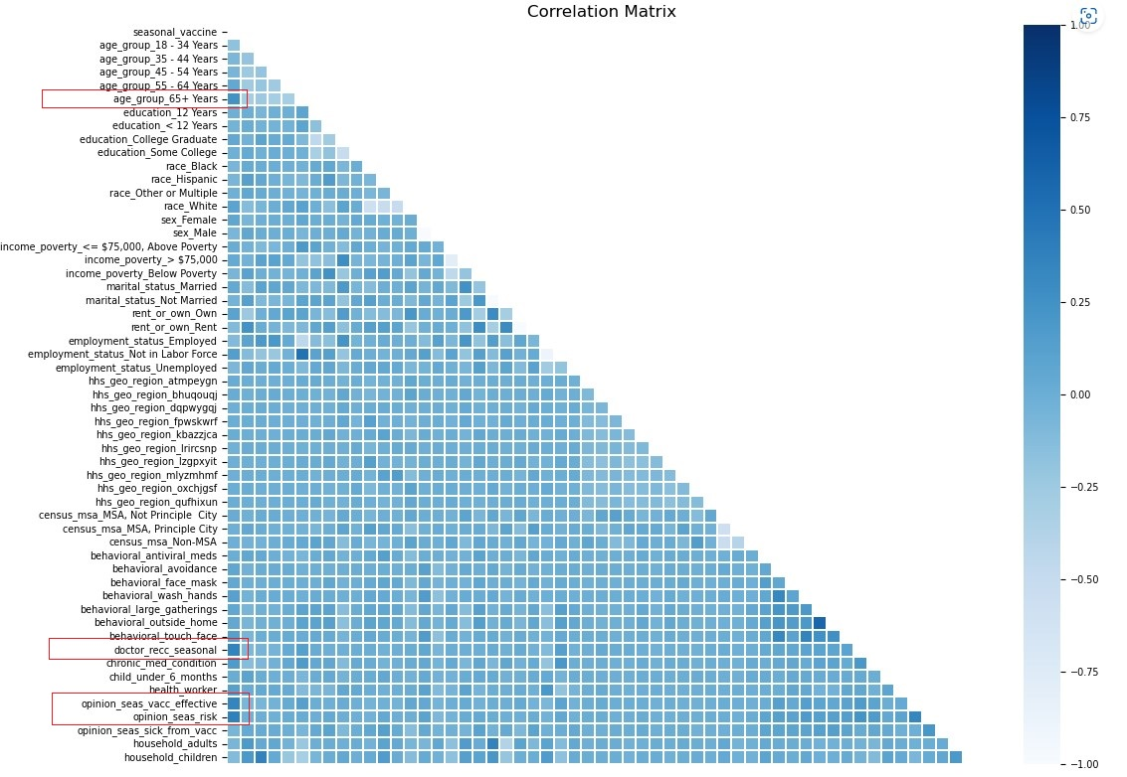
Tuning Model: Features Selection
Correlation matrix used to select top 4 features with highest positive correlation to target variable.
New model with reduced features had slightly lower accuracy (75.15%), but was simpler and faster to train and predict.
Additional features may be correlated with other features or irrelevant to target variable.

Slide 8
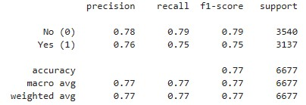
Tuning Model: RandomizedSearchCV
20 models trained over 2 folds of cross-validation (40 total).
Best fit selected based on accuracy.
Best hyperparameters: n_estimators = 207, max_features = 10, min_samples_split = 23.
Resulting accuracy score: 77.18%, an improvement on baseline model.

Slide 9
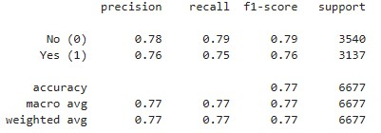
Tuning Model: GridSearchCV
Algorithm trains and evaluates model for every combination of values in specified hyperparameter grid.
Model with highest mean score across cross-validation folds is selected as best model, with best combination of hyperparameters retained
Guaranteed to find optimal combination of hyperparameters
Resource intensive as examines all combinations
Final accuracy score: 77.28%, an improvement on the baseline model

Slide 10
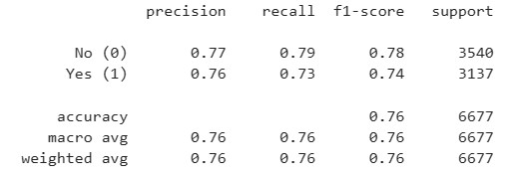
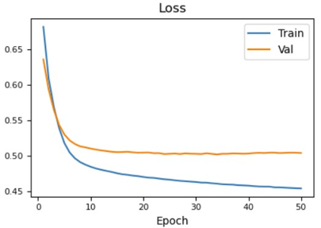
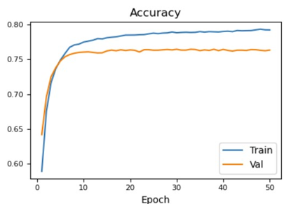
Deep Learning Model
Binary classification using a neural network. The neural network is:
Two-layer deep that uses “relu” activation function on both layers
Compiled using the “binary_crossentropy” loss function, the “adam” optimiser and the “accuracy” evaluation metrics.
Fitted using 50 epochs and 1000 batch size.
This model has an accuracy score of 76.25%, slightly higher than baseline.
Notes:
As the number of Epochs increases the loss decreases up to roughly 0.52. From the plot above, the loss “gap” between training and valuation set increase as the epochs increase. This could be a sign that the model is overfitting.

Slide 11
Evaluation
Hyperparameter tuning using GridSearchCV resulted in higher accuracy score (77.28%) but was more resource intensive
RandomizedSearchCV also improved accuracy and less resource intensive. It is recommended when there is a large parameter space.
Limiting number of features resulted in slightly lower accuracy, but simpler and faster model
Hyperparameter tuning is a useful method for improving performance of random forest model, with RandomizedSearchCV most effective and efficient in our case.
The chosen simple neural network model has similar predictive power as the baseline. Further tuning may increase the accuracy and outperform the baseline.
Model | Accuracy
Baseline | 76.13%
Features Selection | 75.15%
RandomizedSearchCV | 77.18%
GridSearchCV | 77.28%
Deep Learning Model | 76.35%

Slide 12
Future Work
Try different model configurations or algorithms
Train the model with different feature subsets
Evaluate models using additional performance metrics, e.g. precision and recall F1 Score to get a more comprehensive understanding of the model performance.
Further tuning the neural network model such as introducing more layers, dropout regularisation and tuning the learning rate.

